Slide 1
Can “Dumb” beat “smart”? On Access channel design for mobile IoT
Shu wang, ph.d.

Slide 2
summary
Due to the signal processing limitation, traditionally access channel user capacity or throughput capacity is viewed as a function of timing ( or Smartness I) and power control ( or Smartness II)
Aloha vs. Slotted Aloha
From an information-theory perspective, the optimal channel capacity is achievable through power control (Smartness II) and interference cancellation,
Perfect timing information may not be necessary.
The proposed approach is to achieve the optimal channel capacity through
Extended low power access or transmission
Early termination

Slide 3
outline
Background
Aloha access channel model
Mobile IoT (internet of things)
What Are The Problems?
IoT’s impact to existing mobile networks
Access success rate
Optimal Solutions :
Smart & Short Access Probe
Dumb & Long Access Probe.
Other considerations.

Slide 4
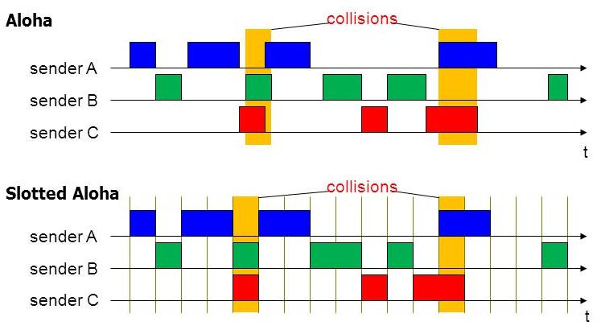
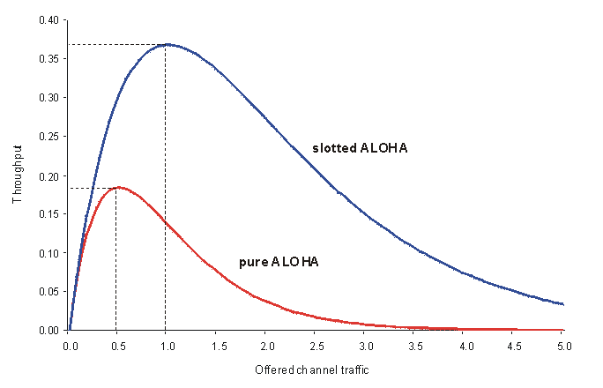
Background (1/3): Aloha channel model

Slide 5
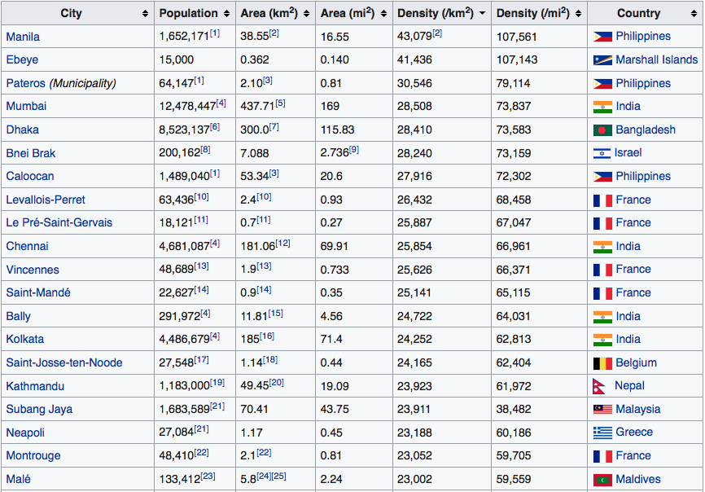
Background (2/3): Internet of things (IoT)
IoT networks are expected to connect billions of devices in the next several years.
One ambitious 5G requirement is to serve massive Internet of Things (IoT).
Obviously these requirements are highly expected for the IoT networks operated in high population density cities, where a large portion of IoT end-devices will be deployed.
For example, as shown in the table below, the population density in Chennai, India is 25,854 per Km².
If in average it is assumed that one IoT device per capita and the coverage of one IoT base station is 4 Km in radius, the number of the served IoT devices per base station is expected to be 25,854 x 3.14 x 16 = 1,298,905.
This means, considering a 30-minute period and assuming that there is no retransmission in a 4 km IoT network deployed in Chennai, India, the expected access capacity is 1,298,905 access per 30 minutes.

Slide 6
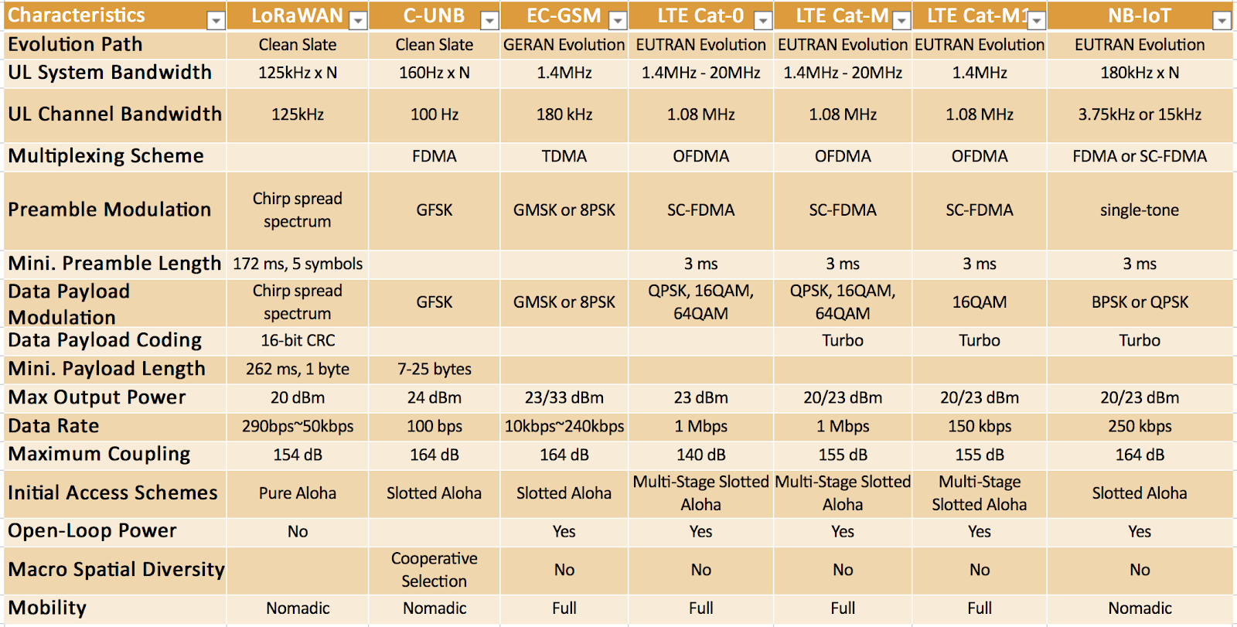
Background (2/3): Mobile IoT

Slide 7
The problems
#1 issue for mobile system upgrade is how to minimize the impact on the existing network services when IoT terminals increase.
Channelization: minimize the overlapping between legacy probes and IoT probes
Power Control: minimize the interference to legacy 1x services.
#2 issue is to improve IoT terminals access success rate, which doesn’t always conflict with Issue #1.
The challenges to the existing mobile networks are
RoT (Rise over Thermal) increase: the RoT contribution from IoT terminals
Interference/collision: the potential dimension limit of current UL channels.
Other related problems are
The macro-diversity and detection complexity dilemma
The network imbalance.
The load and throughput dilemma
Additional considerations are
Improve terminal battery life.
Improve network Positioning.

Slide 8
Answers to issue #1 (1/2): Dumb vs. smart
Two Completely Different Answers: Dumb vs. Smart.
Very SMART & SHORT access probe.
“Smart” means the probe knows the access timing of others.
It always arrives inside some access gap and has little overlap with existing access probes.
In order to be smarter, an access probe need be shorter.
A short access length means high Tx power and data rate.
Very DUMB & LONG access probe.
“Dumb” means it has no timing information of other probes.
For exploring access gaps, each probe is very long instead.
Long probe usually means low Tx power, low data rate and more diversity opportunities possible.
Low data rate means more redundancy and protection.
Coding gain and processing gain v.s. Tx Power
Two Different Views: Power Control vs. Timing.
For smart probes, timing information is the challenge and key.
For dumb probes, power control is the key.

Slide 9
Answers to issue #1 (1/2): comparison
 | Smart Access Probe | Dumb Access Probe | Comments
Require perfect access Timing of other terminals | Yes | No | Different design starting points.
Require power control | No | Yes
Require early termination | No | Yes
Tx Power and Rate Requirement | High Power and High Rate | Low Power and Low Rate
Coding & Processing Gain | Low | High
Interference Contribution | Strong and short period | Low and long period
RoT Contribution | Short period | Long period
Time Diversity Gain | low | High | including channel time diversity, imperfect OL-PC, and interference fluctuation, etc.
Implementation | The “smart” part is hard to be implemented. The “short” part is easy to be implemented | Friendly & Easy

Slide 10
Traditional Thinking of Collision Avoidance

Slide 11
A New Thinking of Collision Avoidance

Slide 12
Early Termination on Long Probes
It is possible for an AP to successfully detect and decode dumb access probes much earlier before a IoT terminal finishes it transmission, due to
Imperfect Open-Loop Power Control.
Interference / RoT Fluctuation.
Channel Time Diversity
As soon as a BS successfully decodes one dumb access probe, it will send ACK in the earliest next paging cycle.
As soon as a IoT terminal successful receives ACK, it will immediately stop the transmission of the rest probe.
Early termination is possible due to the duration of dumb access probes can be more than one paging cycle.

Slide 13
Macro-Diversity on Long Probes
For achieving macro-diversity or soft handoff on RL access probe detection, more than one sectors will simultaneously monitor access probes.
As soon as one sector successfully detects one dumb access probe, it will
Report the access header and payload data to the serving BSC/PCF.
(optional) send ACK through its own paging channel.
If the terminal is monitoring the paging channels of both its serving and neighbor sectors, it will stop the transmission as soon as it receives an ACK through any forward link paging channel it monitors.
Due to network imbalance, it is possible that one of its neighbor sectors can successfully detect access probes much earlier than its serving sector.
Additional macro-diversity capability helps increase early termination granularity.

Slide 14
So … What About Concern #2 ?
Issue #2: will a long and low power access probe design have a low access success rate?
Answer: NO.
ALOHA model suggests two things fundamentally affect access success rates
The Channel. e.g. path-loss, fading, timing and related protocols.
The Signal. e.g. power control, coding and modulation.
Access success rate is NOT determined by probe length.
Accurate timing information is hardly available.
Power control plays a key role in access channel performance.
Early termination is a well-understood and practical way for compensating imperfect power control.

